Slide 1

GRAPH THEORY, APPLICATIONS AND COMBINATORICS
Surabhi Narayan
Department of Computer Science & Engineering

Slide 2

GRAPH THEORY, APPLICATIONS AND COMBINATORICS
EULERIAN GRAPHS
Surabhi Narayan
Department of Computer Science & Engineering

Slide 3
Graph Theory, Applications and Combinatorics
Walk, Path, circuits
Walk
Defined as a finite alternating sequence of vertices and edges beginning and ending with vertices such that each edge is incident with the vertices preceding and following it.
A walk in the graph G=(V,E) is a finite sequence of the form
v_{i0}, e_{j1}, v_{i1}, e_{j2}, ……. e_{jk}, v_{ik}
v₂
e₂
v₃
e₁
v₁
e₈
e₇
e₃
e₅
e₁₀
e₉
v₅
e₆
v₄
v₆
e₄

Slide 4
Graph Theory, Applications and Combinatorics
Walk, Path, circuits
v₂
e₂
v₃
Walk
e₁
v₁
e₈
e₇
e₃
e₅
e₁₀
e₉
v₅
e₆
v₄
v₆
e₄
v₂e₇v₅e₈v₁e₈v₅e₆v₄e₅v₄ is an open walk
v_{i0} and v_{ik} are the end vertices.
v_{i0} is the initial vertex and v_{ik} is the terminal vertex
K is the length of the walk

Slide 5
Graph Theory, Applications and Combinatorics
Walk, Path, circuits
v₂
e₂
v₃
Walk
e₁
v₁
e₈
e₇
e₃
e₅
e₁₀
e₉
v₅
e₆
v₄
v₆
e₄
v₂e₇v₅e₈v₁e₈v₅e₆v₄e₅v₄ is an open walk whereas
v₄e₅v₄e₃v₃e₂v₂e₇v₅e₆v₄ is a closed walk

Slide 6
Graph Theory, Applications and Combinatorics
Walk, Path, circuits
v₂
e₂
v₃
Trail
e₁
v₁
e₈
e₇
e₃
e₅
e₁₀
e₉
v₅
e₆
v₄
v₆
e₄
A walk is a trail if edges of the walk are traversed at most once
v₁e₈v₅e₉v₁e₁v₂e₇v₅e₆v₄e₅v₄e₄v₄ is a trail.

Slide 7
Graph Theory, Applications and Combinatorics
Walk, Path, circuits
v₂
e₂
v₃
Path
e₁
v₁
e₈
e₇
e₃
e₅
e₁₀
e₉
v₅
e₆
v₄
v₆
e₄
A trail is a path wherein vertices are visited at most once.
v₂e₇v₅e₆v₄e₃v₃ is a path.
A closed trail is a circuit whereas a closed path is a cycle.
v₅e₇v₂e₂v₃e₃v₄e₄v₄e₆v₅ is a circuit whereas
v₅e₇v₂e₂v₃e₃v₄e₆v₅ is a cycle

Slide 8
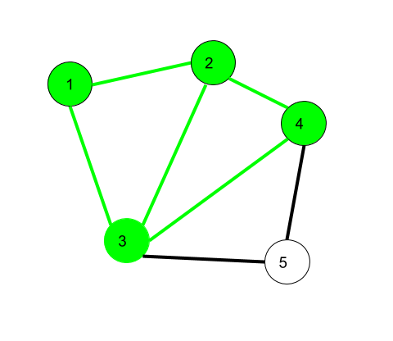
Graph Theory, Applications and Combinatorics
Walk, Path, circuits
Walk
1->2->3->4->2->1->3 is a walk

Slide 9
Graph Theory, Applications and Combinatorics
Walk, Path, circuits
Walk
1->2->3->4->2->1->3 is an open walk
1->3->2->4->3->2->1 is an closed walk

Slide 10
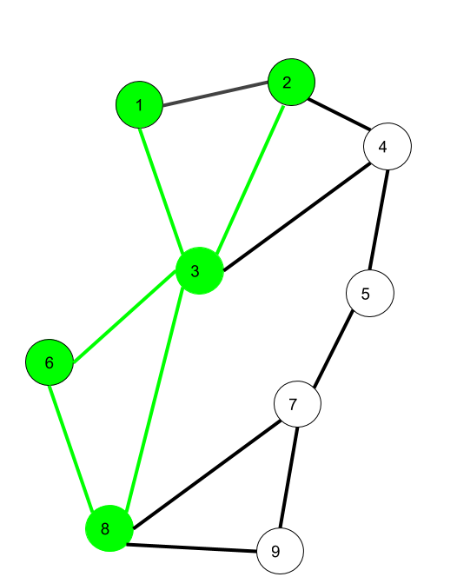
Graph Theory, Applications and Combinatorics
Walk, Path, circuits
Trail
1->3->8->6->3->2 is an open trail
1->3->8->6->3->2->1 is an closed trail

Slide 11
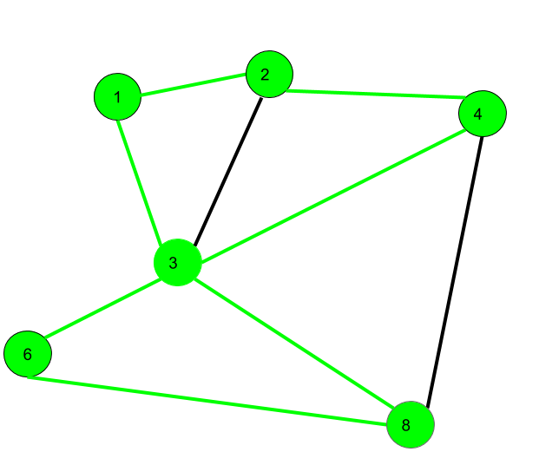
Graph Theory, Applications and Combinatorics
Walk, Path, circuits
Path, Circuit and Cycle
1->2->4->3->8->6->3 is a path
1->2->4->3->8->6->3 ->1 is a circuit
1->2->4->8->6->3->1 is a cycle

Slide 12
Graph Theory, Applications and Combinatorics
Walk, Path, circuits
Eulerian Graph
Euler Graph - A connected graph G is called a Euler graph, if there is a closed trail which includes every edge of the graph G.
Euler Path - A Euler path is a path that uses every edge of a graph exactly once. A Euler path starts and ends at different vertices.
Euler Circuit - A Euler circuit is a circuit that uses every edge of a graph exactly once. A Euler circuit always starts and ends at the same vertex. A connected graph G is a Euler graph if and only if all vertices of G are of even degree, and a connected graph G is Eulerian if and only if its edge set can be decomposed into cycles.

Slide 13
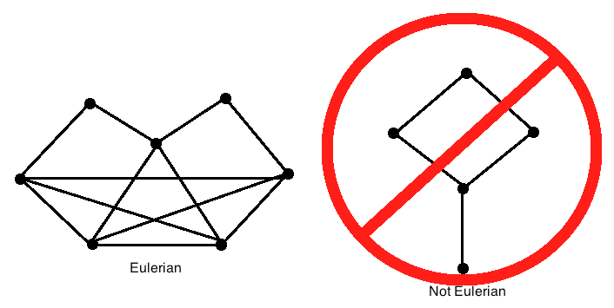
Graph Theory, Applications and Combinatorics
Walk, Path, circuits
7
8
9
10
1
2
4
3
5
6
11
12

Slide 14
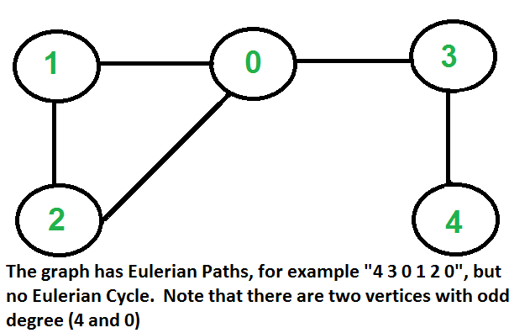
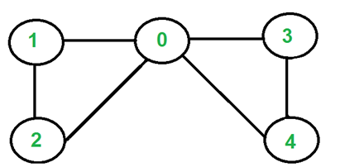
Graph Theory, Applications and Combinatorics
Walk, Path, circuits
The graph has Euler circuit but not Euler cycle. Note that all vertices are of even degree
A graph is called Eulerian if it has a Eulerian Circuit and called Semi-Eulerian if it has a Eulerian Path.

Slide 15
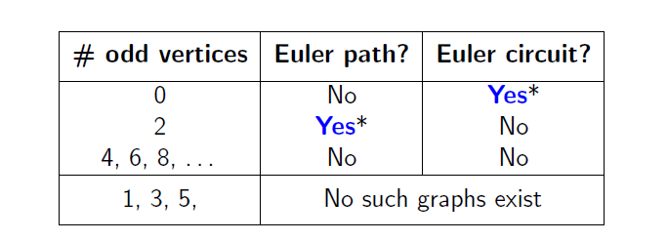
Graph Theory, Applications and Combinatorics
Walk, Path, circuits
Is it possible to determine whether a graph has an Euler path or an Euler circuit, without necessarily having to find one explicitly?
If a graph G has an Euler path, then it must have exactly two odd vertices.
If a graph G has an Euler circuit, then all of its vertices must be even vertices.

Slide 16
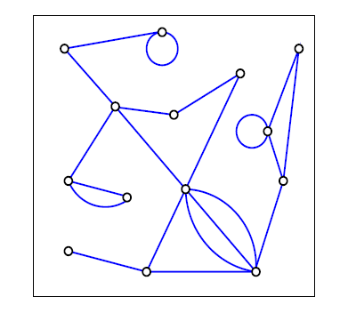
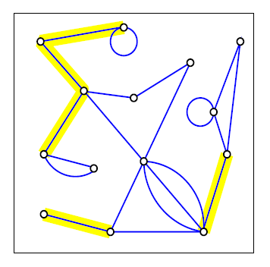
Graph Theory, Applications and Combinatorics
Walk, Path, circuits
Bridges
Removing a single edge from a connected graph can make it disconnected. Such an edge is called a bridge.

Slide 17
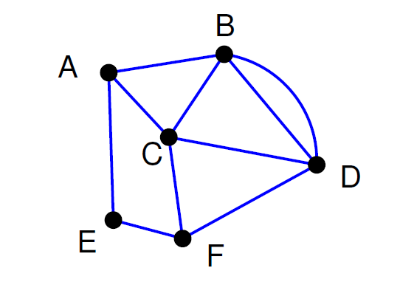
Graph Theory, Applications and Combinatorics
Walk, Path, circuits
Find an Euler circuit in the graph below.
There are two odd vertices, A and F. Let’s start at F.

Slide 18
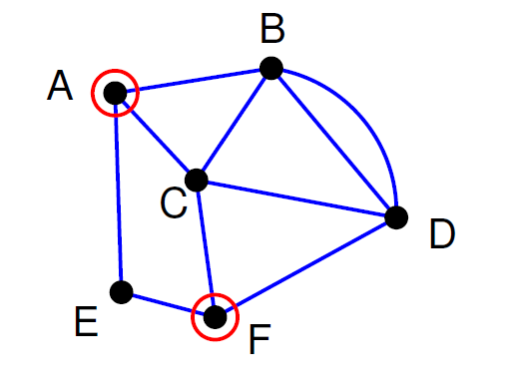
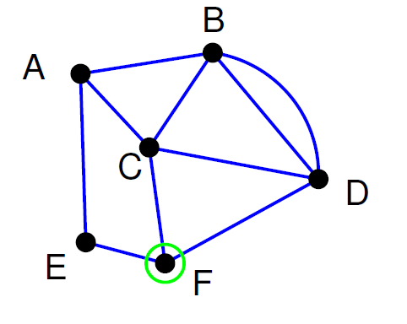
Graph Theory, Applications and Combinatorics
Walk, Path, circuits
Start walking at F. When you use an edge, delete it.

Slide 19
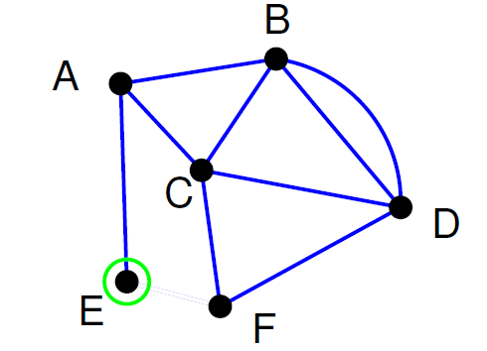
Graph Theory, Applications and Combinatorics
Walk, Path, circuits
Path so far: FE

Slide 20
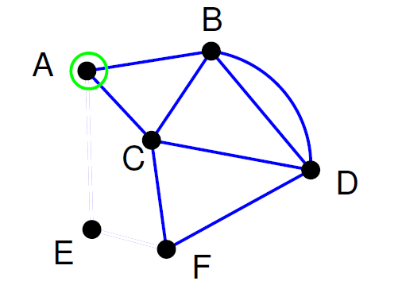
Graph Theory, Applications and Combinatorics
Walk, Path, circuits
Path so far: FEA

Slide 21
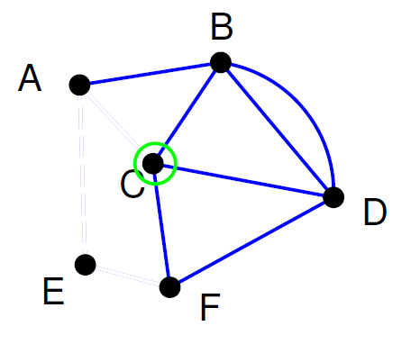
Graph Theory, Applications and Combinatorics
Walk, Path, circuits
Path so far: FEAC

Slide 22
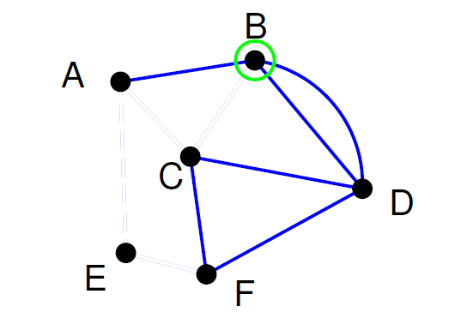
Graph Theory, Applications and Combinatorics
Walk, Path, circuits
Path so far: FEACB

Slide 23
Graph Theory, Applications and Combinatorics
Walk, Path, circuits
Path so far: FEACB
Crossing the edge BA would be a mistake, because we would be stuck there. The reason is that BA is a bridge. Cross a bridge only if it is the only edge available

Slide 24
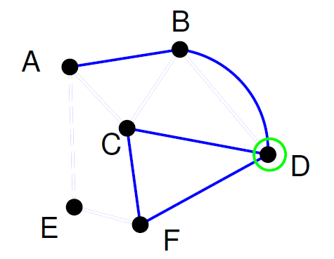
Graph Theory, Applications and Combinatorics
Walk, Path, circuits
Path so far: FEACBD

Slide 25
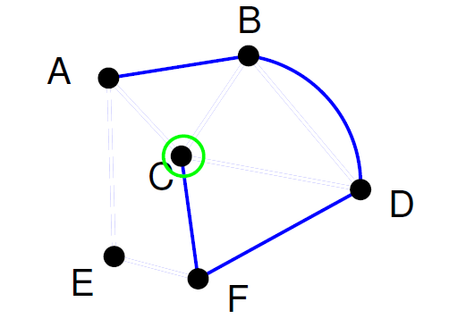
Graph Theory, Applications and Combinatorics
Walk, Path, circuits
Path so far: FEACBDC

Slide 26
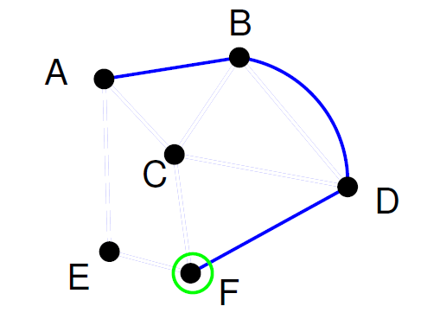
Graph Theory, Applications and Combinatorics
Walk, Path, circuits
Path so far: FEACBDCF

Slide 27
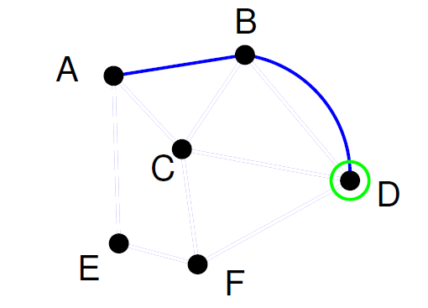
Graph Theory, Applications and Combinatorics
Walk, Path, circuits
Path so far: FEACBDCFD

Slide 28
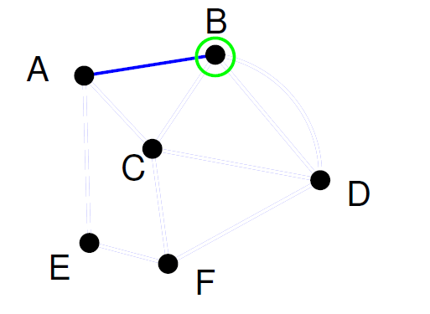
Graph Theory, Applications and Combinatorics
Walk, Path, circuits
Path so far: FEACBDCFDB

Slide 29
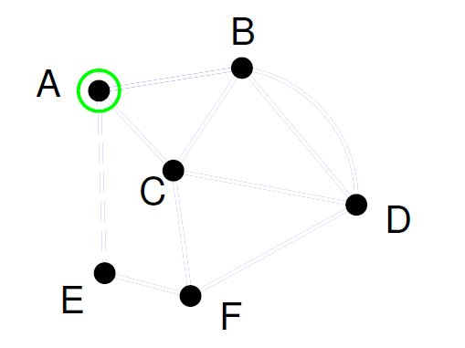
Graph Theory, Applications and Combinatorics
Walk, Path, circuits
Path so far: FEACBDCFDBA
Euler Path: FEACBDCFDBA

Slide 30
Graph Theory, Applications and Combinatorics
Walk, Path, circuits
Fleury’s Algorithm
Make sure the graph has either 0 or 2 odd vertices.
If there are 0 odd vertices, start anywhere. If there are 2 odd vertices, start at one of them.
Follow edges one at a time. If you have a choice between a bridge and a non-bridge, always choose the non-bridge.
Stop when you run out of edges.

Slide 31
Graph Theory, Applications and Combinatorics
Walk, Path, circuits
Is the graph Eulerian?
f
a
b
g
d
c
h
e

Slide 32
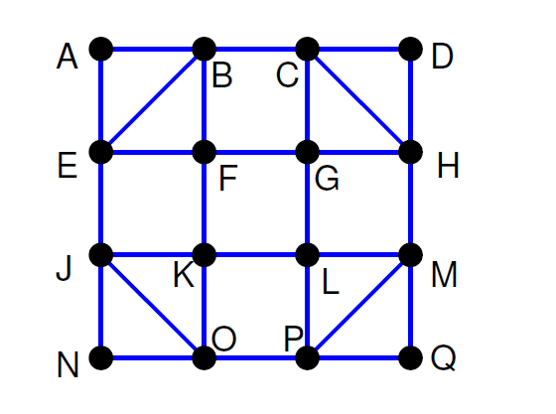
Graph Theory, Applications and Combinatorics
Walk, Path, circuits
Is the graph Eulerian?

Slide 33
Graph Theory, Applications and Combinatorics
Walk, Path, circuits
Is the graph Eulerian?

Slide 34
Graph Theory, Applications and Combinatorics
Walk, Path, circuits
Is the graph Eulerian?

Slide 35
Graph Theory, Applications and Combinatorics
Walk, Path, circuits
Is the graph Eulerian?

Slide 36
Graph Theory, Applications and Combinatorics
Walk, Path, circuits
Is the graph Eulerian?

Slide 37
Graph Theory, Applications and Combinatorics
Walk, Path, circuits
Is the graph Eulerian?

Slide 38
Graph Theory, Applications and Combinatorics
Walk, Path, circuits
Is the graph Eulerian?

Slide 39
Graph Theory, Applications and Combinatorics
Walk, Path, circuits
Is the graph Eulerian?

Slide 40
Graph Theory, Applications and Combinatorics
Walk, Path, circuits
Is the graph Eulerian?

Slide 41
Graph Theory, Applications and Combinatorics
Walk, Path, circuits
Is the graph Eulerian?

Slide 42
Graph Theory, Applications and Combinatorics
Walk, Path, circuits
Is the graph Eulerian?

Slide 43
Graph Theory, Applications and Combinatorics
Walk, Path, circuits
Is the graph Eulerian?

Slide 44
Graph Theory, Applications and Combinatorics
Walk, Path, circuits
Is the graph Eulerian?

Slide 45
Graph Theory, Applications and Combinatorics
Walk, Path, circuits
Is the graph Eulerian?

Slide 46
Graph Theory, Applications and Combinatorics
Walk, Path, circuits
Is the graph Eulerian?

Slide 47
Graph Theory, Applications and Combinatorics
Walk, Path, circuits
Is the graph Eulerian?

Slide 48
Graph Theory, Applications and Combinatorics
Walk, Path, circuits
Is the graph Eulerian?

Slide 49
Graph Theory, Applications and Combinatorics
Walk, Path, circuits
Is the graph Eulerian?

Slide 50
Graph Theory, Applications and Combinatorics
Walk, Path, circuits
Is the graph Eulerian?

Slide 51
Graph Theory, Applications and Combinatorics
Walk, Path, circuits
Is the graph Eulerian?

Slide 52
Graph Theory, Applications and Combinatorics
Walk, Path, circuits
Is the graph Eulerian?

Slide 53
Graph Theory, Applications and Combinatorics
Walk, Path, circuits
Is the graph Eulerian?

Slide 54
Graph Theory, Applications and Combinatorics
Walk, Path, circuits
Is the graph Eulerian?

Slide 55
Graph Theory, Applications and Combinatorics
Walk, Path, circuits
Is the graph Eulerian?

Slide 56
Graph Theory, Applications and Combinatorics
Walk, Path, circuits
Is the graph Eulerian?

Slide 57
Graph Theory, Applications and Combinatorics
Walk, Path, circuits
Is the graph Eulerian?

Slide 58
Graph Theory, Applications and Combinatorics
Walk, Path, circuits
Is the graph Eulerian?

Slide 59
Graph Theory, Applications and Combinatorics
Walk, Path, circuits
Is the graph Eulerian?

Slide 60
Graph Theory, Applications and Combinatorics
Walk, Path, circuits
Is the graph Eulerian?

Slide 61
Graph Theory, Applications and Combinatorics
Walk, Path, circuits
Theorem : A connected graph G is a Euler graph if and only if all vertices of G are of even degree.
Proof:
Necessity: Let G(V, E) be a Euler graph.
Thus G contains a Euler walk Z.
Let this walk start and end at the vertex u ∈ V
Since each visit of Z to an intermediate vertex v of Z contributes two to the degree of v and since Z traverses each edge exactly once, d(v) is even for every such vertex.

Slide 62
Graph Theory, Applications and Combinatorics
Walk, Path, circuits
Theorem : A connected graph G is a Euler graph if and only if all vertices of G are of even degree.
Proof
Sufficiency :
Let Graph G be a graph with every vertex having even degree.
To prove: Graph G is Eulerian.

Slide 63
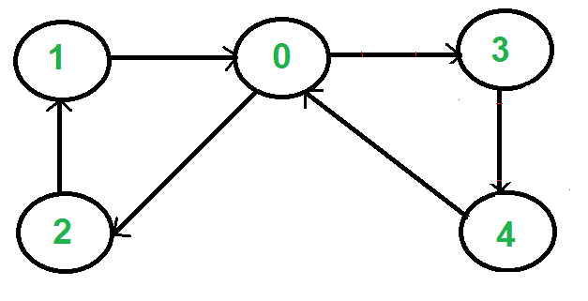
Graph Theory, Applications and Combinatorics
Walk, Path, circuits
Euler Circuit in Directed Graphs
A directed graph has an eulerian cycle if following conditions are true
All vertices with nonzero degree belong to a single strongly connected component
In degree is equal to the out degree for every vertex.

Slide 64
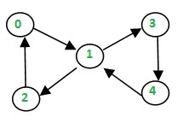
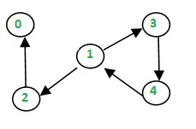
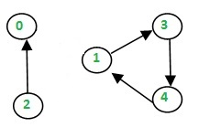
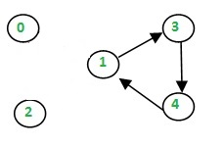
Graph Theory, Applications and Combinatorics
Walk, Path, circuits
Heirholzer’s Algorithm
0—1—2– 0

Slide 65
Graph Theory, Applications and Combinatorics
Walk, Path, circuits
Heirholzer’s Algorithm
1—3—4—1
0—1—2—0
Combine the two
0—1—(3—4—1)—2—0

Slide 66
Graph Theory, Applications and Combinatorics
Walk, Path, circuits
Heirholzer’s Algorithm
a—b—c—a
b—d—c—e—d—b
Combine the two circuits
a—b—d—c—e—d—b—c—a
a
b
c
a—b—c—a
c—e—d—c
b—d—b
Combine the three circuits
a—b—d—b—c—e—d—c—a
d
e

Slide 67
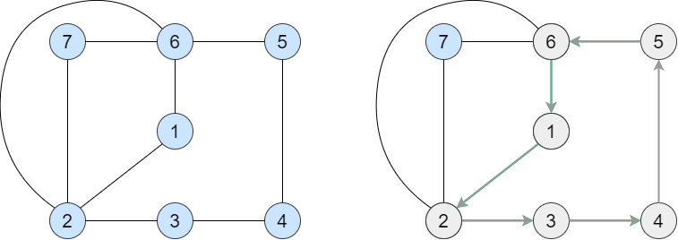
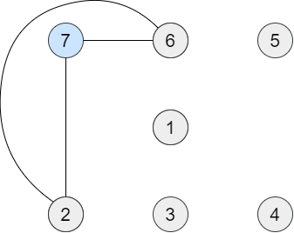
Graph Theory, Applications and Combinatorics
Walk, Path, circuits
Heirholzer’s Algorithm
1-2-3-4-5-6-1
6-7-2-6
On combining them, we get
1-2-3-4-5-(6-7-2-6)-1

Slide 68
Graph Theory, Applications and Combinatorics
Walk, Path, circuits
Heirholzer’s Algorithm
First, make sure that the input graph G is connected and contains exactly 0 or 2 odd degree vertices.
Initialize 2 stack. The first stack will store the temporary Euler Path – let’s call it cpath. The second stack will store the final Euler path – let’s call it epath.
Let the starting vertex be v. If the graph contains exactly 2 odd degree vertices then one of them should be the starting vertex. If the graph contains exactly 0 odd degree vertices then any vertex can be starting vertex.
Push v to cpath.

Slide 69
Graph Theory, Applications and Combinatorics
Walk, Path, circuits
Heirholzer’s Algorithm
5. Let u = cpath.top
6. If all the edges from u are visited, pop u from cpath and push it to epath.
7. If all edges from u are not visited, select any random edge (u, x). Push x to cpath and delete the edge (u, x) from G.
8. Repeat steps 5 to 7 until cpath is empty.
9. The final Euler path will be saved in epath.

Slide 70
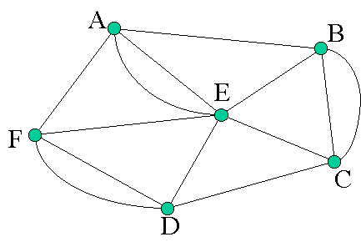
Graph Theory, Applications and Combinatorics
Walk, Path, circuits
Heirholzer’s Algorithm

Slide 71
Graph Theory, Applications and Combinatorics
Walk, Path, circuits
Heirholzer’s Algorithm
a
b
c
a
d
e
f
g
h
i
j
k

Slide 72
Graph Theory, Applications and Combinatorics
Walk, Path, circuits
Which of the following graphs contain an Euler path? Which contain an Euler circuit?
K4
K5
K5,7
K2,7
C7
P7
Ans: K4 does not have an Euler path or circuit.
K5 has an Euler circuit, but not a Euler path.
K5,7 does not have an Euler path or circuit.
K2,7 has an Euler path but not a Euler circuit.
C7 has an Euler circuit (it is a circuit graph!)
P7 has an Euler path but not a Euler circuit

Slide 73
Graph Theory, Applications and Combinatorics
Walk, Path, circuits
For which n does the graph Kn contain an Euler circuit? Explain.
When n is odd, Kn contains an Euler circuit. This is because every vertex has degree n−1, so an odd n results in all degrees being even.

Slide 74
Graph Theory, Applications and Combinatorics
Walk, Path, circuits
For which m and n does the graph Km,n contain an Euler path? An Euler circuit? Explain.
If both m and n are even, then Km,n has an Euler circuit. When both are odd, there is no Euler path or circuit. If one is 2 and the other is odd, then there is an Euler path but not an Euler circuit.

Slide 75
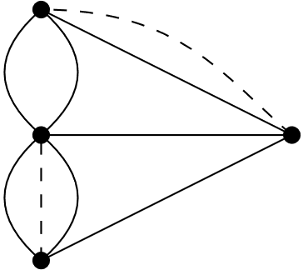
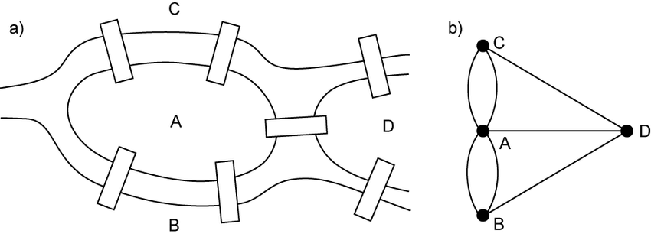
Graph Theory, Applications and Combinatorics
Walk, Path, circuits
A bridge builder has come to Königsberg and would like to add bridges so that it is possible to travel over every bridge exactly once. How many bridges must be built?
If we build one bridge, we can have an Euler path. Two bridges must be built for an Euler circuit.

Slide 76
THANK YOU
Surabhi Narayan
Department of Computer Science &Engineering
surabhinarayan@pes.edu

